Slide 1
Ethical Control of Unmanned Systems Mission Design and Semantic Web Exemplars for Human Supervision of Lethal/Lifesaving Autonomy
Don Brutzman and Curt Blais, Naval Postgraduate School (NPS)
U.S. Semantic Technologies Symposium (US2TS)
Panel session: Hybrid AI for Context Understanding
North Carolina State University, Raleigh, NC
9-11 March 2020
Notes:
Distribution is unrestricted. See Open-Source License for Ethical Control for details controlling this work.

Slide 2

US Semantic Technologies Symposium (US2TS) Session: Hybrid AI for Context Understanding
What is nature of context that described hybrid AI system is trying to understand?
Validate human orders to remote unmanned systems with capacity for lethal/lifesaving force.
Ethics for Rules of Engagement (ROE), Laws of Armed Conflict (LOAC), operational constraints.
What specific methods and technologies does this hybrid AI system use, and how?
Validatable XML mission syntax using controlled vocabularies with corresponding ontology.
Perform SPARQL queries of RDF/OWL to check complex relationships, requirements, violations.
Conversions for declarative orders, language implementations, Turtle triples with Protégé, ARQ.
What are current limitations in presented solution, what is plan for future work?
Representative test cases are being tested in simulation to build out verification framework.
Supports maritime operations with tractable Identification Friend Foe Neutral Unknown (IFFNU).
Expand scope with larger mission sets for diverse operations by unmanned systems in real world.
Bridge command and control (C2) with modeling and simulation (M&S) virtual environments, for
Domain-expert qualification of hardware/software systems using tactical scenarios as unit tests.

Slide 3
Synopsis: Ethical Control of Unmanned Systems
Project Motivation: ethically constrained control of unmanned systems and robot missions by human supervisors and warfighters.
Precept: well-structured mission orders can be syntactically and semantically validated to give human commanders confidence that offboard systems
will do what they are told to do, and further
will not do what they are forbidden to do.
Project Goal: apply Semantic Web ontology to scenario goals and constraints for logical validation that human-approved mission orders for robots are semantically coherent, precise, unambiguous, and without internal contradictions.
Long-term Objective: demonstrate that no technological limitations exist that prevent applying the same kind of ethical constraints on robots and unmanned vehicles that already apply to human beings.
Paraphrase: can qualified robots correctly follow human orders?
https://savage.nps.edu/EthicalControl

Slide 4
Autonomous Vehicle Command Language (AVCL)
AVCL is a command and control language for humans supervising autonomous unmanned vehicles.
Clarity arises from close correspondence to human naval terminology.
Structured vocabulary defining terms and relationships for mission planning, execution, conduct, recording and replay across diverse robot types.
Common-ground XML representations for
Mission agenda plans, mission scripts, and post-mission recorded telemetry results.
Future work: defining unit tests and expected results for verification and validation.
Operators have single archivable, validatable format for robot tasking, results
directly convertible to and from a wide variety of different robot command languages.
Mission Tasking
https://savage.nps.edu/Savage/AuvWorkbench/AVCL/AVCL.html

Slide 5
Example AVCL mission agenda, as pseudo-code XML
<?xml version="1.0" encoding="UTF-8"?>
<UUVMission>
<GoalSet>
<Goal area=”A” id=”goal1”>
<Search nextOnSuccess=”goal2” nextOnFailure=”goal3”/>
</Goal>
<Goal area=”A” id=”goal2”>
<SampleEnvironment nextOnSuccess=”goal3”
nextOnFailure=”recover”/>
</Goal>
<Goal area=”B” id=”goal3”>
<Search nextOnSuccess=”goal4” nextOnFailure=”goal4”/>
</Goal>
<Goal area=”C” id=”goal4”>
<Rendezvous nextOnSuccess=”recover” nextOnFailure=”recover”/>
</Goal>
<Goal area=”recoveryPosition” id=”recover”>
<Transit nextOnSuccess=”missionComplete” nextOnFailure=”missionAbort”/>
</Goal>
</GoalSet>
</UUVMission>
AVCL is readable by human or robot,
captures logic of mission tasking
XML ensures syntactically correct, well-defined, numerically valid
Needed: semantic representation
to check ethical, logical consistency

Slide 6
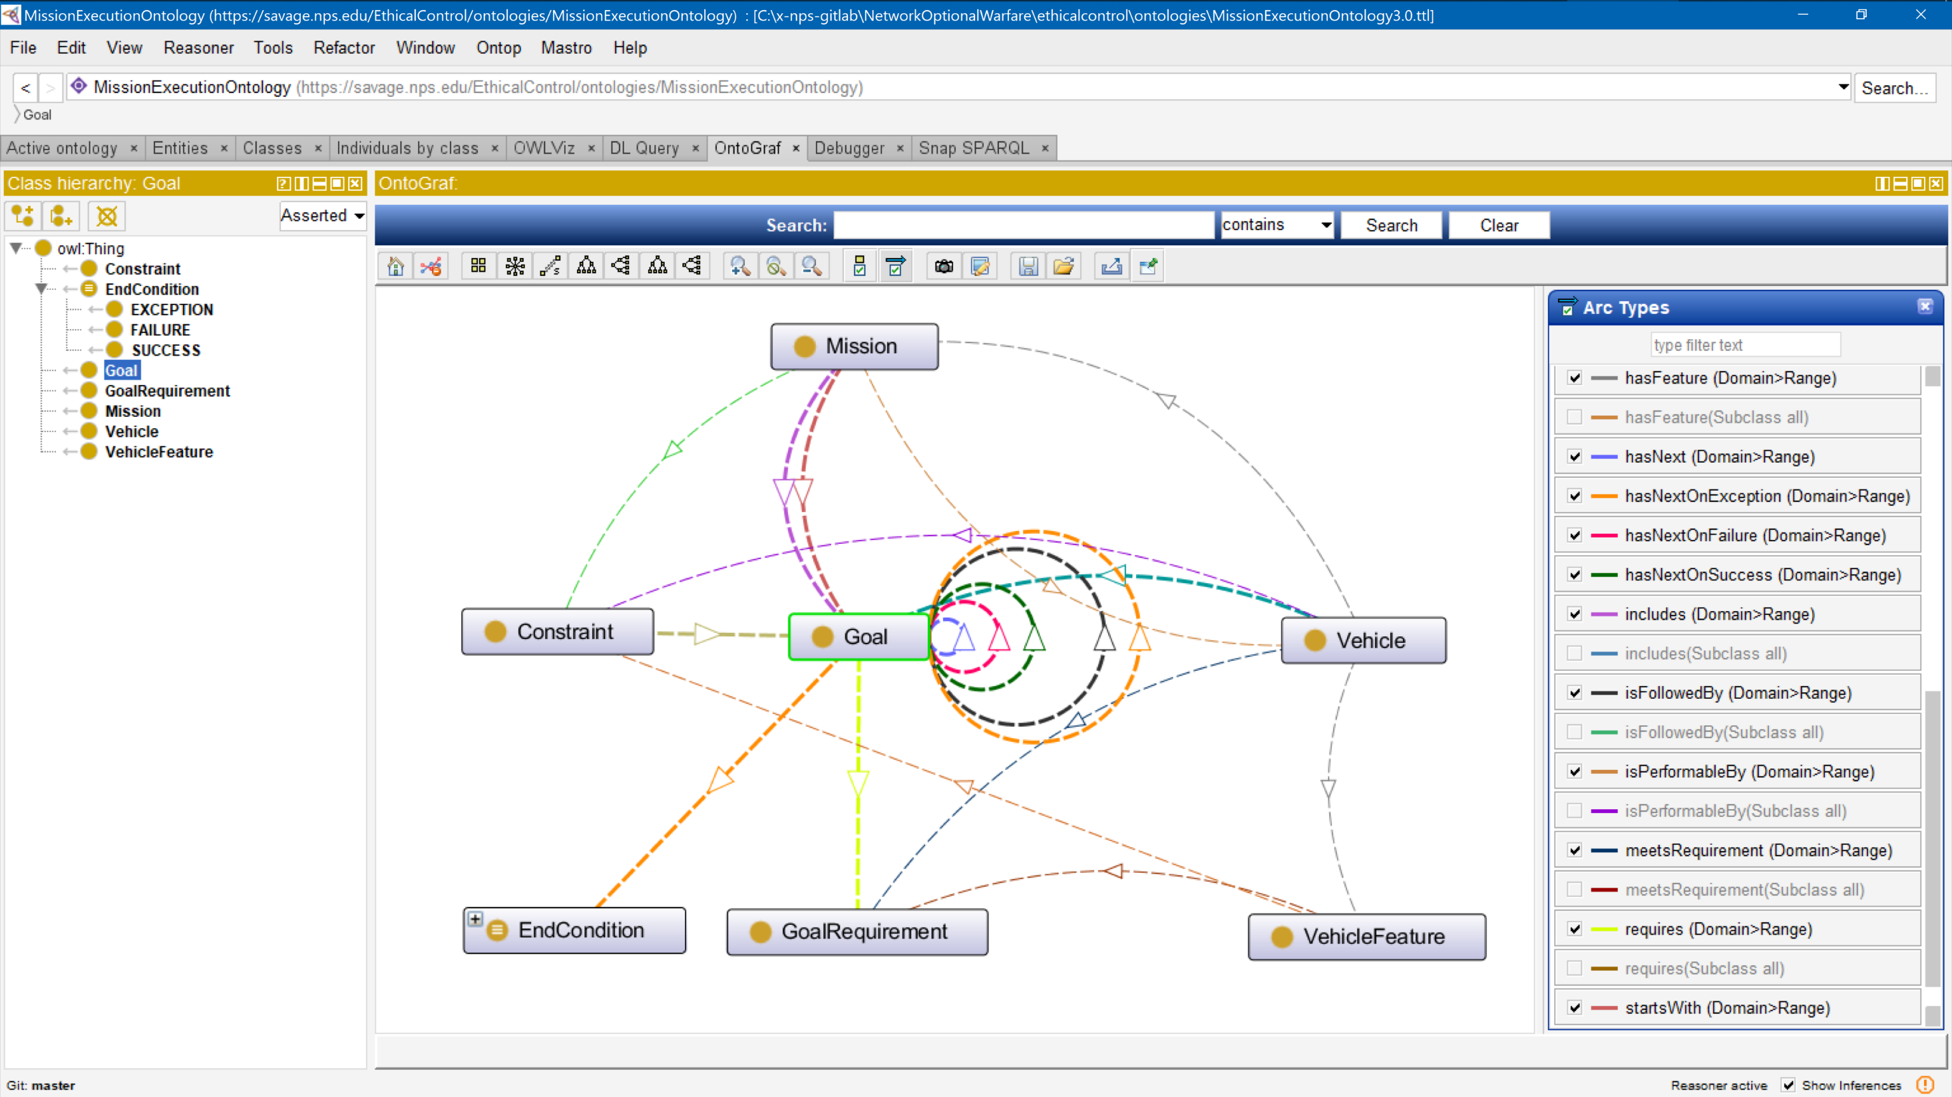
Mission Execution Ontology (MEO) source implemented, tested using Protégé tool

Slide 7
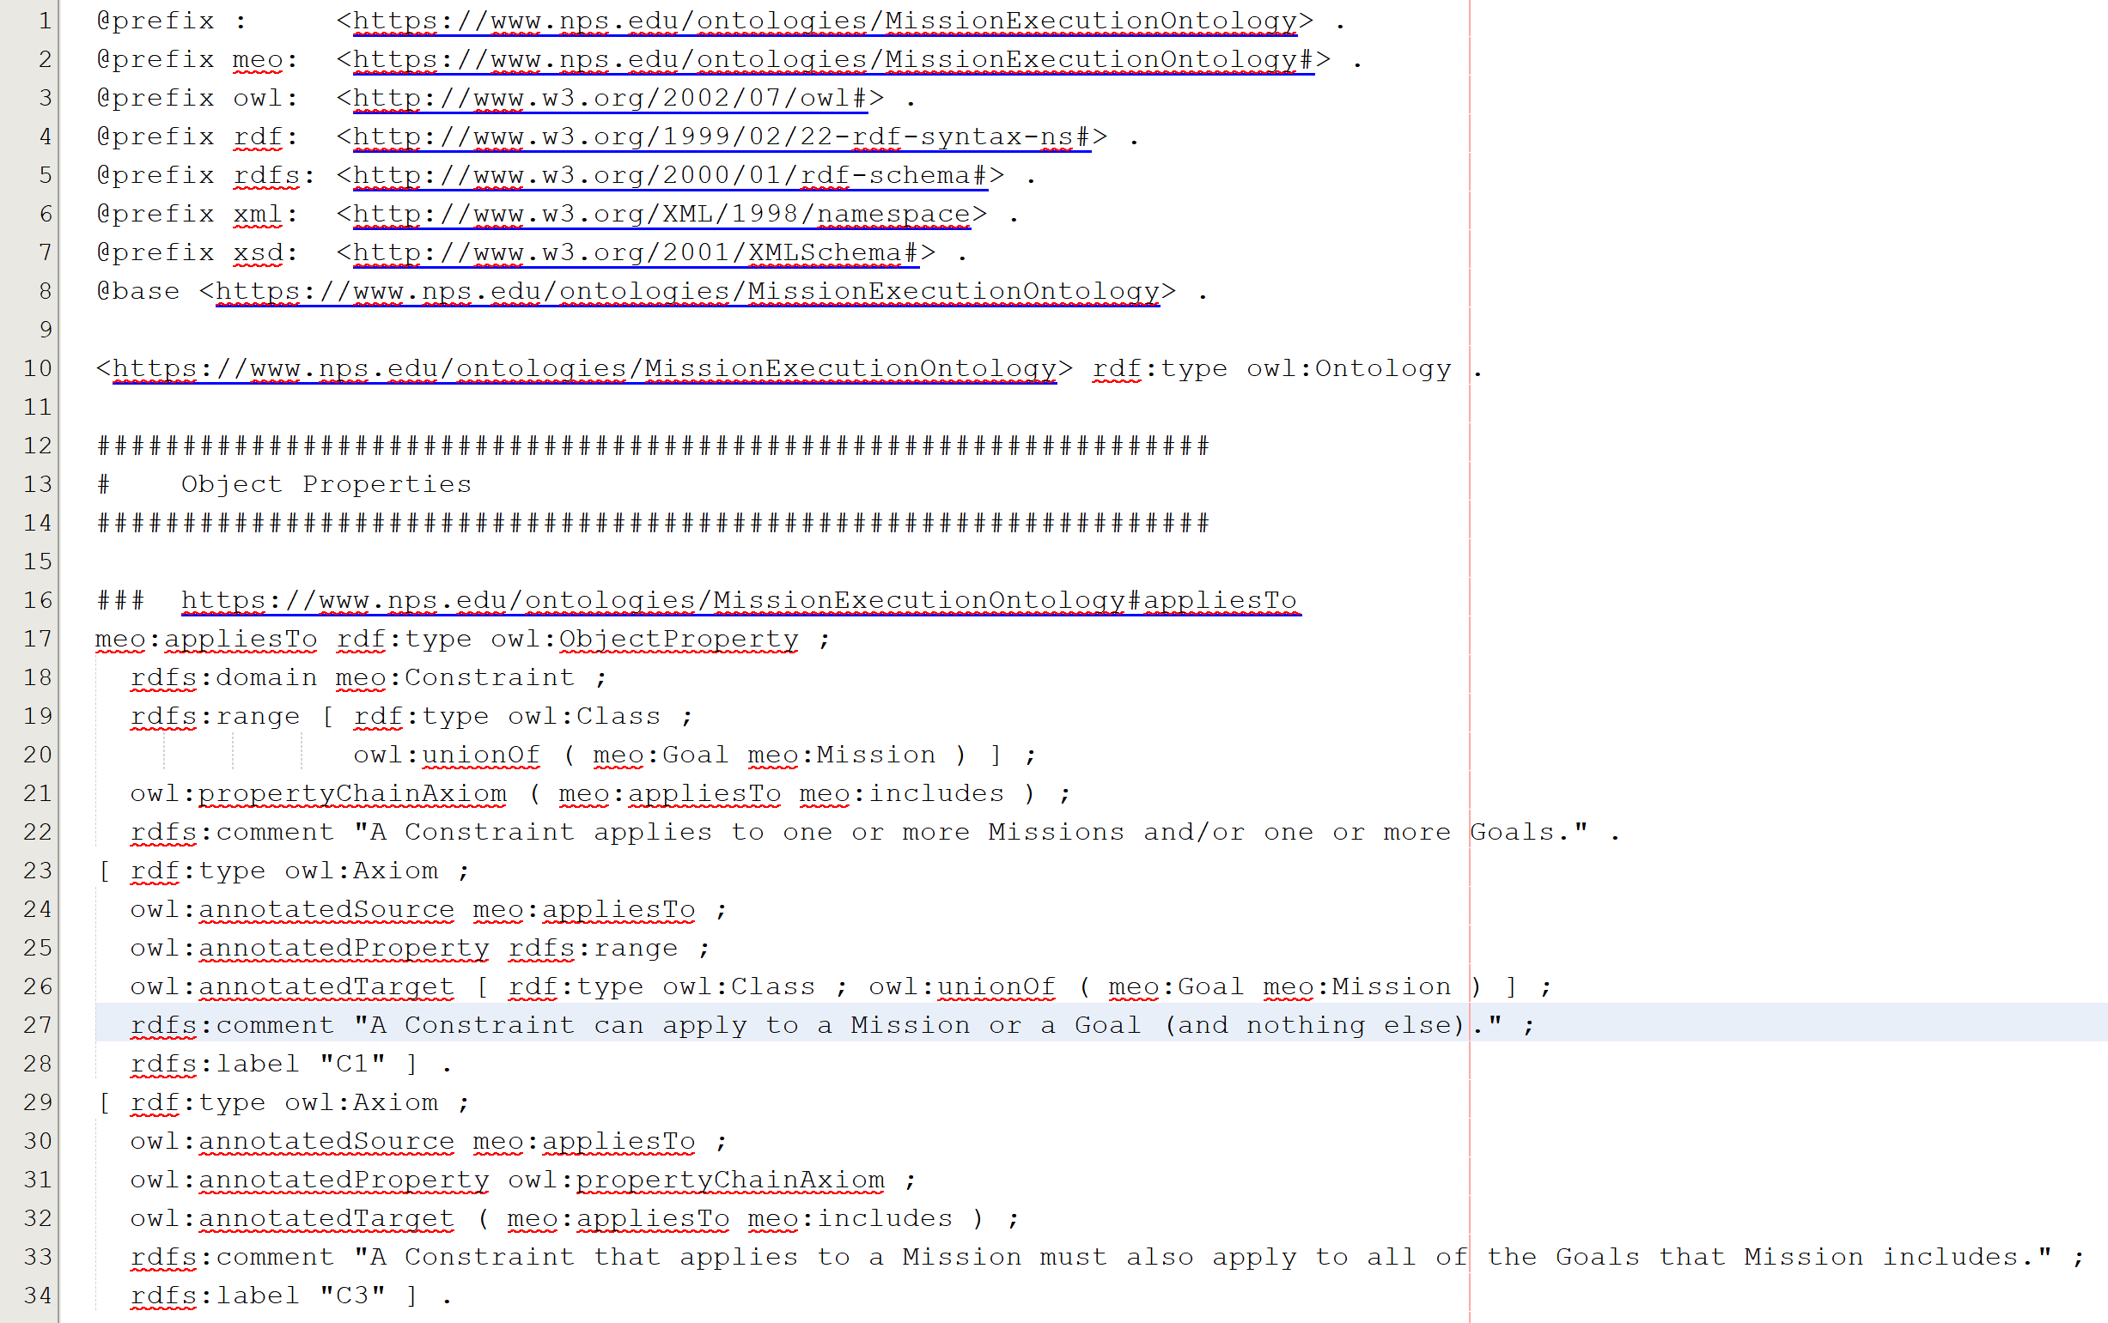
Mission Execution Ontology (MEO) source implemented, tested using Protégé tool
Turtle (.ttl) syntax

Slide 8
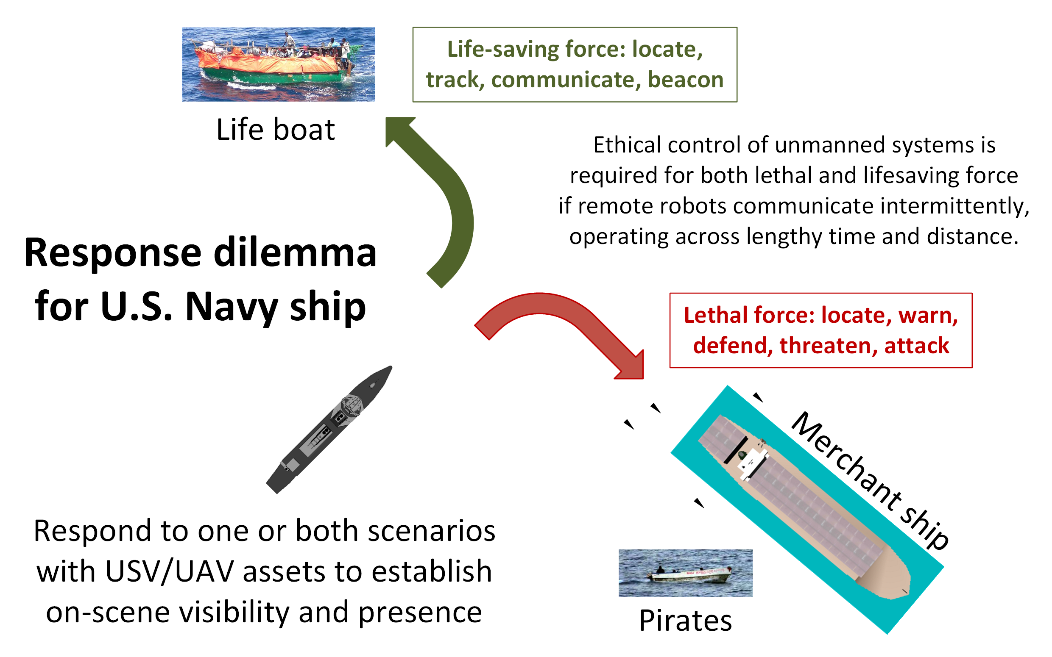
Ship response dilemma

Slide 9
Sailor Overboard Mission: Description
Purpose
Life saving: single unmanned air/surface vehicle actions to complement human responses when performing “SAILOR OVERBOARD” operations.
Carried out in direct concert with formal shipboard emergency procedures.
Multiple UAVs/USVs might be employed in parallel with ships and aircraft, avoid mutual interference by each following deconflicted mission orders.
Phases
Deploy/Launch, Rendezvous, Track Sailor until Safe, Return/Recovery.
Human Supervisory Role
Order standoff if interfering, manual control is possible due to proximity, can communicate to sailor via loudspeaker or beacon light.

Slide 10
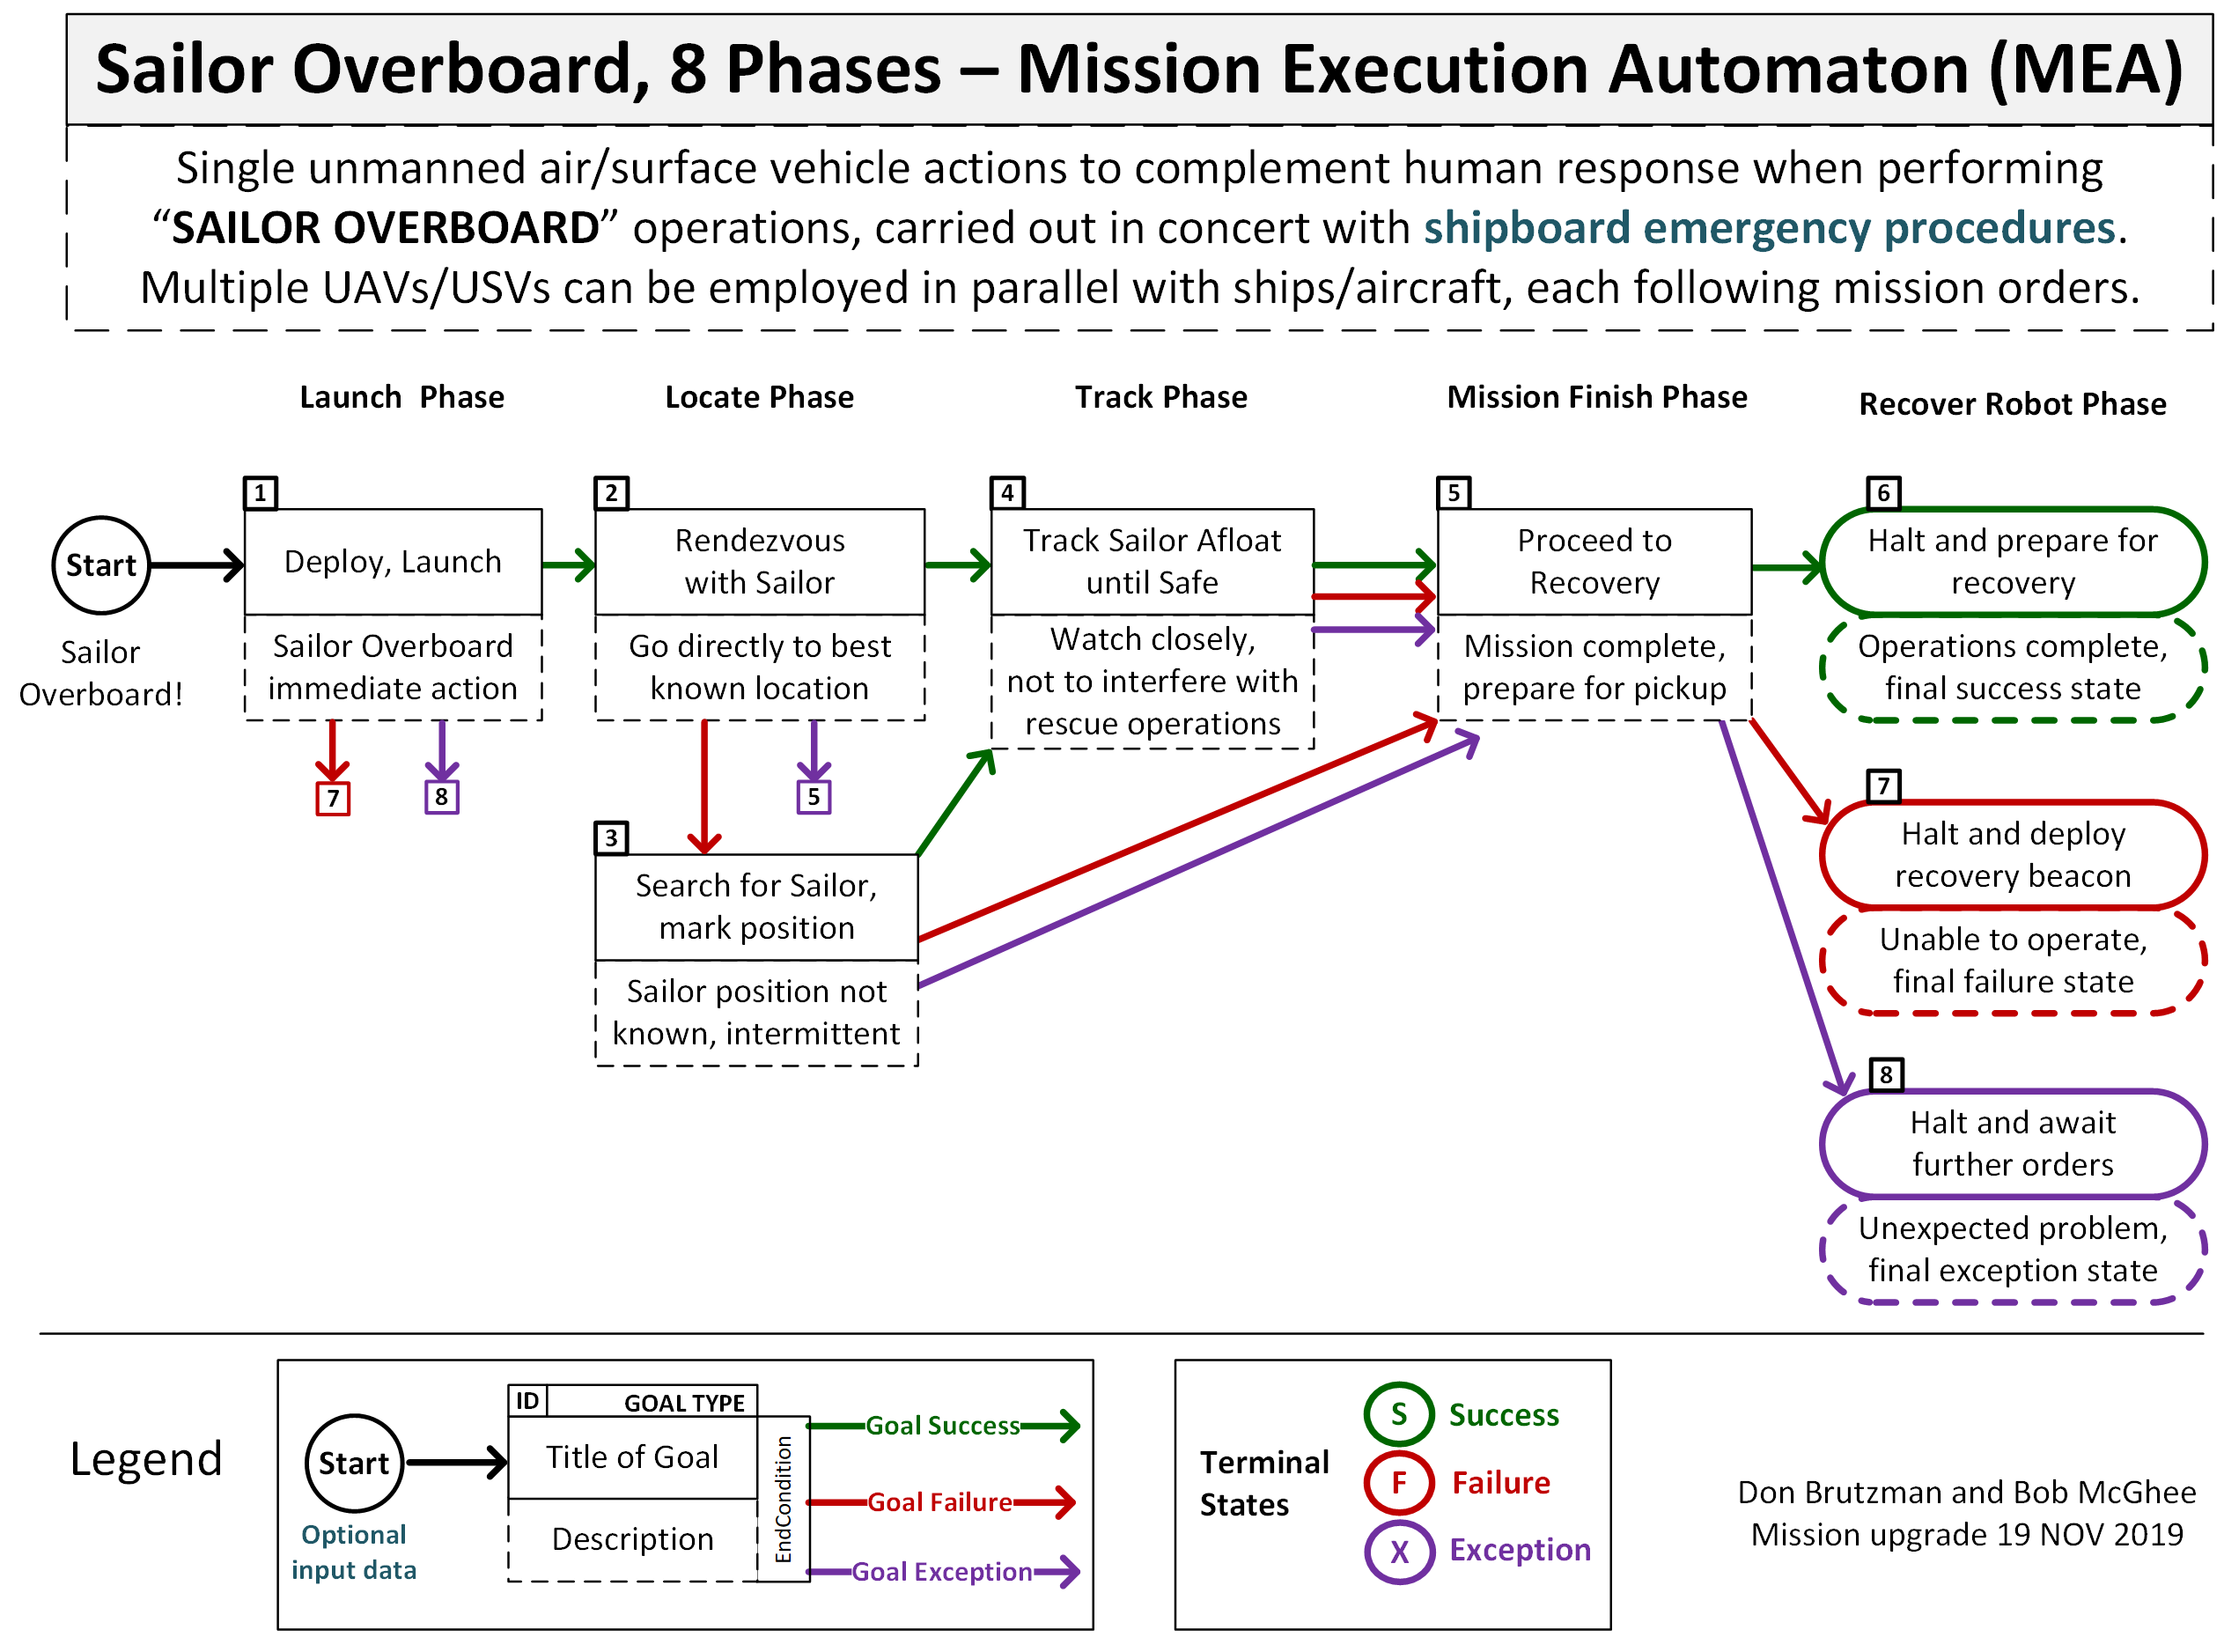
Sailor overboard mission diagram

Slide 11
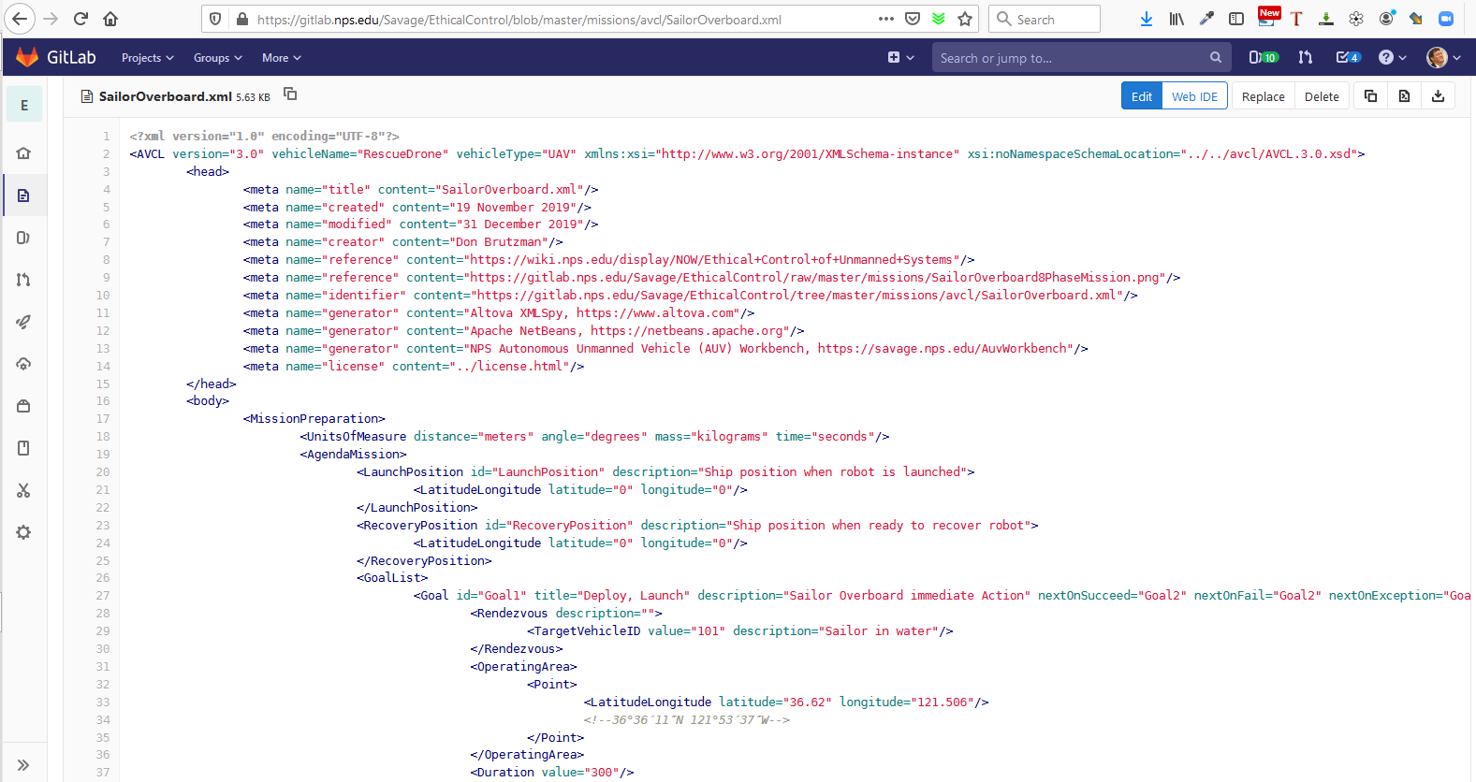
SailorOverboard.xml in gitlab.nps.edu version control

Slide 12
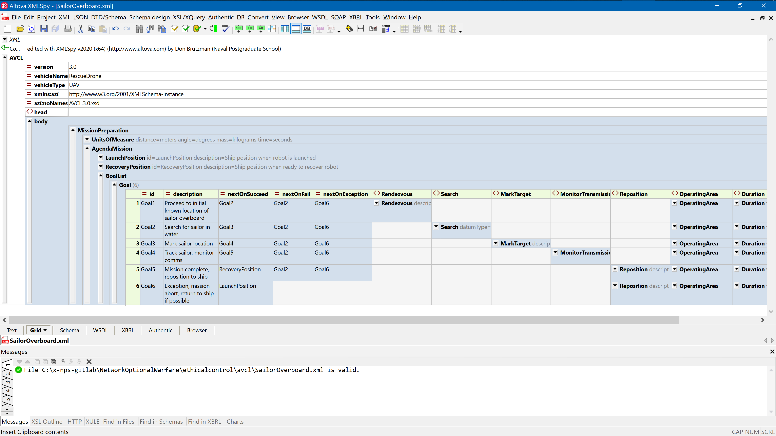
Sailor overboard mission orders AVCL

Slide 13
Ontology for Ethical Control of Unmanned Systems in a Surrogate Scenario: Example Relationship Definitions
Mission Definition Expressed in Subject-Predicate-Object Triples Using Semantic Web Standards
Excerpt of Sailor Overboard Mission, expressed in Turtle Syntax:
### https://www.nps.edu/ontologies/MissionExecutionOntology/missions#Goal_Launch
:Goal_Launch rdf:type owl:NamedIndividual ;
meo:hasNextOnFail :Goal_FailureDiagnosis ;
meo:hasNextOnSucceed :Goal_TransitSearch ;
meo:hasNextOnViolate :Goal_FailureDiagnosis .
### https://www.nps.edu/ontologies/MissionExecutionOntology/missions#Goal_TransitSearch
:Goal_TransitSearch rdf:type owl:NamedIndividual ;
meo:hasNextOnFail :Goal_SearchForSailorAdrift ;
meo:hasNextOnSucceed :Goal_TrackSailorAfloat ;
meo:hasNextOnViolate :Goal_FailureDiagnosis .

Slide 14
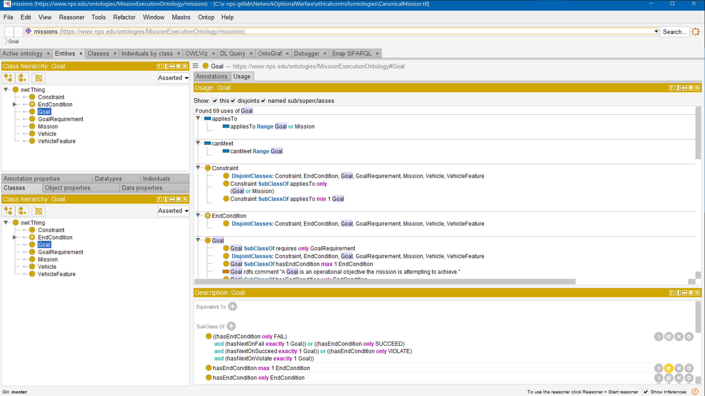
Sailor overboard mission .ttl Turtle

Slide 15
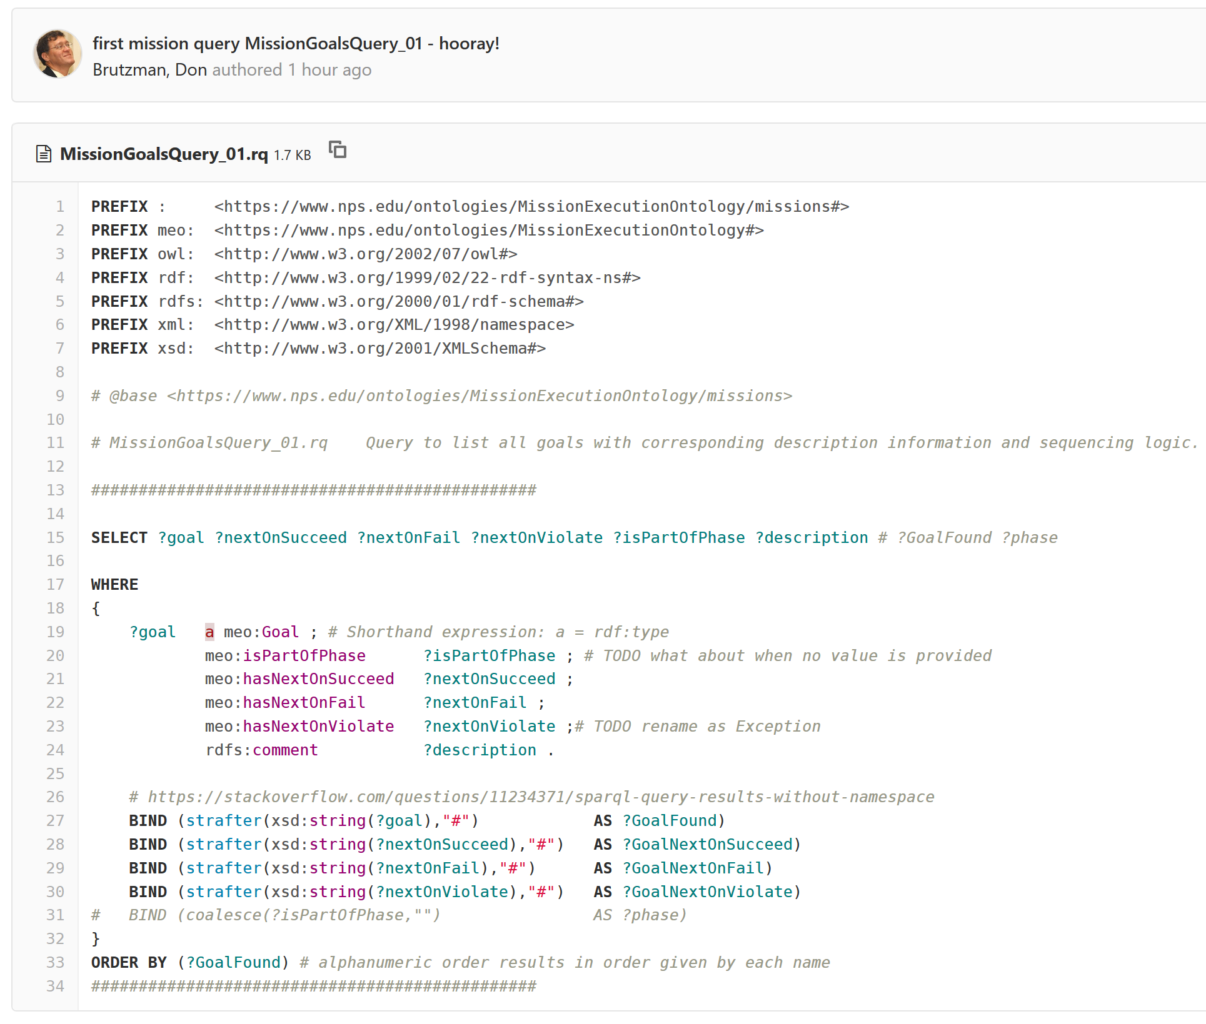
SPARQL mission query MissionQuery_01_GoalBranches.rq

Slide 16
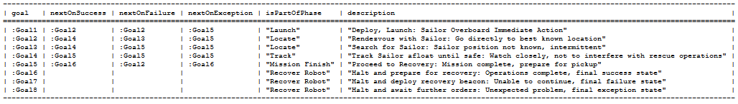
SPARQL query response SailorOverboardConverted. MissionQuery_01_GoalBranches.rq.txt
SPARQL query response
SailorOverboardConverted. MissionQuery_02_InitialGoal.rq.txt

Slide 17
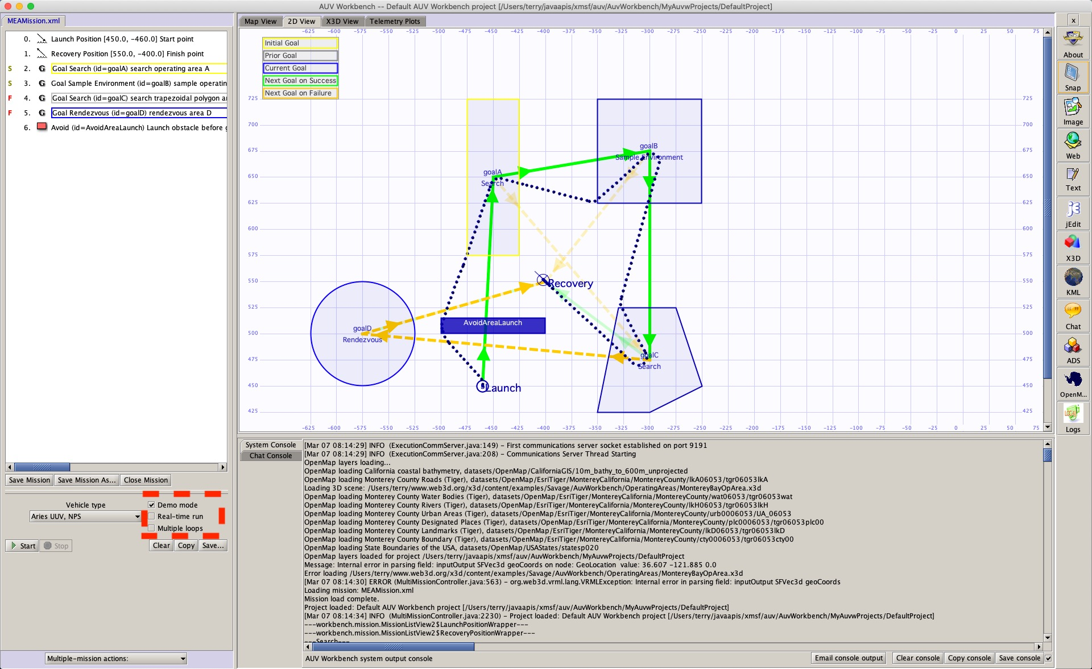
Example simulation using AUV Workbench
UPDATE IN
PROGRESS

Slide 18
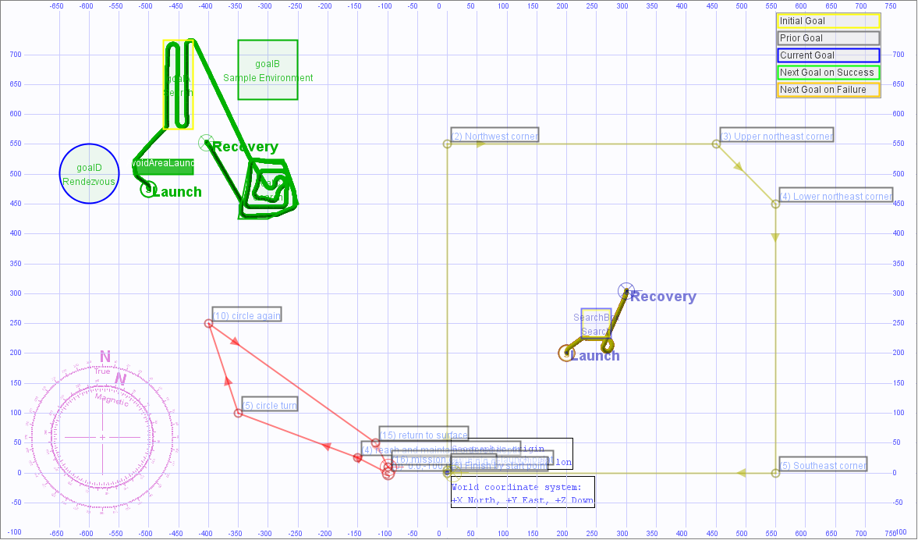
4 earlier example missions, UUV and USV

Slide 19
Not suitable for brute-force numerical computation
AI algorithms for Machine Learning (ML) and Data Mining are often based on statistically training against large datasets to find patterns for filters.
For example, convolutional neural networks, genetic algorithms, reinforcement learning, etc.
Often requires identifying right/wrong matches within large search spaces.
Such predictive analytics are useful for classification models using detailed and noisy sensor data. Given the central importance of IFFNU and some conditional communications to ethical control, ML filters can be helpful if carefully applied.
Nevertheless such approaches are not appropriate for carefully following Rules of Engagement (ROEs), Laws of Armed Conflict (LOAC) or other ethical prerequisites, especially when human expertise and judgement is essential for robot teams.
(Similarly, massive computation or Quantum Computing approaches might be useful in some problems, but are not of practical use for Ethical Control mission orders given by human commanders judiciously guiding remote mobile robots)
Naval history has long shown that sound human judgement is crucial for assessing best strategies and courses of action in ill-structured contexts. Semantic Web approaches are preferable and actionable for Ethical Control.

Slide 20
OODA Significance for Ethical Control
Classical robotic Sense-Decide-Act cycle for closed-loop control is insufficient for proper delegation of lethal (or lifesaving) force to unmanned systems.
Observe-Orient-Decide-Act (OODA) Loop is essential for coherent operations.
Observe includes direct sensing and communication inputs.
Orientation includes thorough Rules of Engagement (ROE) constraints and identification friend/foe/neutral/unknown (IFFNU) of all relevant contacts.
Decision logic of unmanned system tactics, techniques, procedures (TTP) includes authorization and confirmation by human supervisors, either in real-time or in advance, for critical steps leading to lethal force.
Actions in tandem with direct or intermittent human supervisory command enables effective Ethical Control of remote systems.
Feedback loops are essential, generally leading to… more effective operations.

Slide 21


IEEE P7000-series Standards Projects https://ethicsinaction.ieee.org
P7000 Model Process for Addressing Ethical Concerns during System Design
P7001 Transparency of Autonomous Systems
P7002 Data Privacy Process
P7003 Algorithmic Bias Considerations
P7004 Standard on Child and Student Data Governance
P7005 Standard on Employee Data Governance
P7006 Standard on Personal Data AI Agent Working Group
P7007 Ontological Standard for Ethically driven Robotics and Automation Systems
P7008 Standard for Ethically Driven Nudging for Robotic, Intelligent and Autonomous Systems
P7009 Standard for Fail-Safe Design of Autonomous, Semi-Autonomous Systems
P7010 Well-being metrics Standard for Ethical Artificial Intelligence and Autonomous Systems
P7011 Stadard for the Porcess of Identifying and Rating the Trustworthiness of News Sources
P7012 Standard for Machine Readable Personal Privacy Terms
P7014 Standard for Ethical Considerations in Emulated Empathy in Autonomous and Intelligent Systems

Slide 22

IEEE Standards Project P7007 for Ontological Standard for Ethically driven Robotics and Automation Systems
IEEE Global Initiative on Ethics of Autonomous and Intelligent Systems.
https://ethicsinaction.ieee.org includes large document providing broad rationale.
Includes 15 separate working groups in IEEE Standards Association (IEEE-SA).
Relevant group: P7007, Ethically driven Robotics and Automation Systems.
“IEEE P7007 Standards Project for Ontological Standard for Ethically driven Robotics and Automation Systems establishes a set of ontologies with different abstraction levels that contain concepts, definitions and axioms that are necessary to establish ethically driven methodologies for the design of Robots and Automation Systems.”
http://standards.ieee.org/develop/project/7007.html
Must be IEEE member, observe patent-policy requirements to participate in working group.
“Not the intent to specify required ethical behaviors, but rather to formalize a vocabulary of terms, concepts, and relationships that can be used to enable unambiguous discussion among […] communities regarding what it means for autonomous systems to exhibit ethical behaviors.”
Excellent forum with rich references, worth observation and participation.
Active work: align several Ethical Control terms, concepts, use cases with P7007.

Slide 23
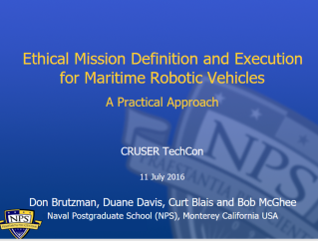
Key Insights regarding Human Ethical Control
Humans in military units are able to deal with moral challenges without ethical quandaries,
by using formally qualified experience, and by following mission orders that comply with Rules of Engagement (ROE) and Laws of Armed Conflict (LOAC).
Ethical behaviors don’t define the mission plan. Instead, ethical constraints inform the mission plan.
Naval forces can only command mission orders that are
Understandable by (legally culpable) humans, then
Reliably and safely executed by robots.
Reference: CRUSER TechCon Overview 2016
https://gitlab.nps.edu/Savage/EthicalControl/tree/master/documents/presentations
Notes:
Laws of Armed Conflict (LOAC) are also referred to as International Humanitarian Law (IHL).

Slide 24
Conclusions
Human supervision is required for any unmanned systems holding potential for lethal force.
Cannot push “big red shiny AI button” and hope for best – immoral, unlawful.
Similar imperatives exist for supervising systems holding life-saving potential.
Human control of unmanned systems is possible at long ranges of time-duration and distance through well-defined mission orders.
Readable and sharable by both humans and unmanned systems.
Validatable syntax and semantics through logical constraints.
Testable and confirmable using simulation and visualization.
Coherent human-system team approach is feasible and repeatable.
Semantic Web confirmation can ensure orders are comprehensive, consistent.
Human role remains essential for life-saving and potentially lethal scenarios.

Slide 25
Contact
Don Brutzman
brutzman@nps.edu
http://faculty.nps.edu/brutzman
Code USW/Br, Naval Postgraduate School
Monterey California 93943-5000 USA
1.831.656.2149 work
1.831.402.4809 cell
Notes:
Questions and feedback are always welcome. Thanks for considering the possibilities.

Slide 26
Contact
Curt Blais
clblais@nps.edu
home page
Code MV/Bl, Naval Postgraduate School
Monterey California 93943-5000 USA
1.831.656.3215 work
Notes:
Questions and feedback are always welcome. Thanks for considering the possibilities.

Slide 27
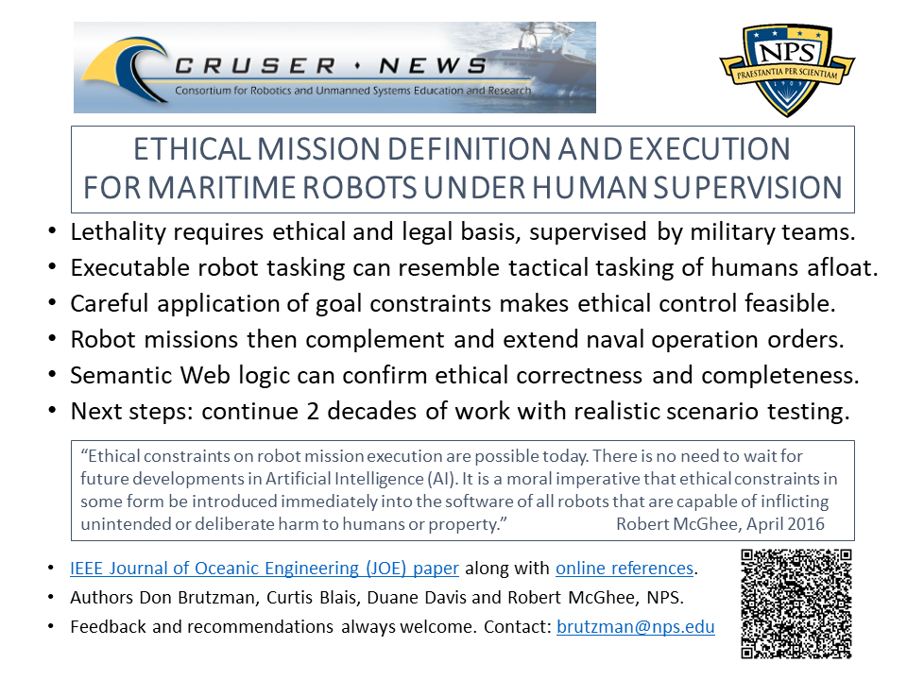
Ethical Control flyer

